Slide 1
Install Window XP
SILICON LAB

Slide 2

Begin the Installation
Insert the Windows XP CD and restart your computer.
If prompted to start from the CD, press SPACEBAR.

Slide 3
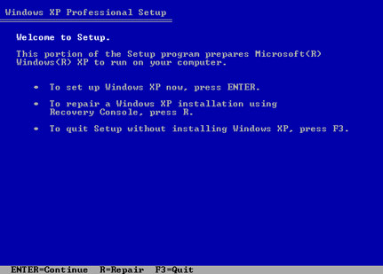
On the Welcome Page
On the Welcome to Setup page, press ENTER.

Slide 4
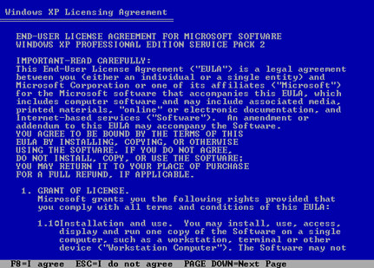
On the Licensing Agreement page
On the Licensing Agreement page, read the licensing agreement. Then press F8.

Slide 5
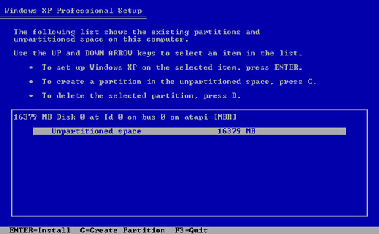
Delete the existing partition
Press D, and then press L when prompted to deletes your existing data.

Slide 6
Partition Selection
Press ENTER to select Unpartitioned space, which appears by default.

Slide 7
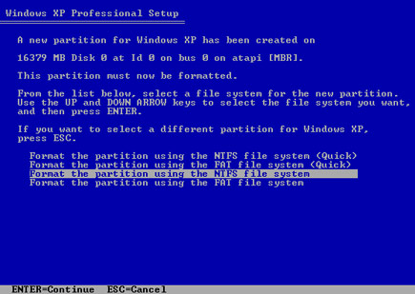
Format the Partition
Press ENTER again to select Format the partition using the NTFS file system.

Slide 8
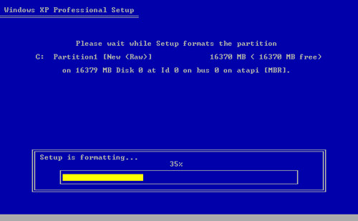
Formatting
Windows XP format the hard drive and then copies the setup files.

Slide 9
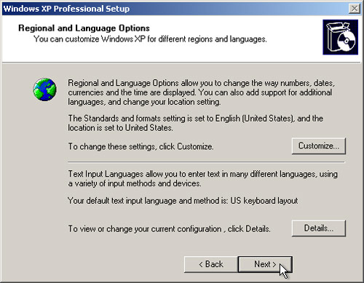
Select Regional and Language Options
After select, click NEXT.

Slide 10
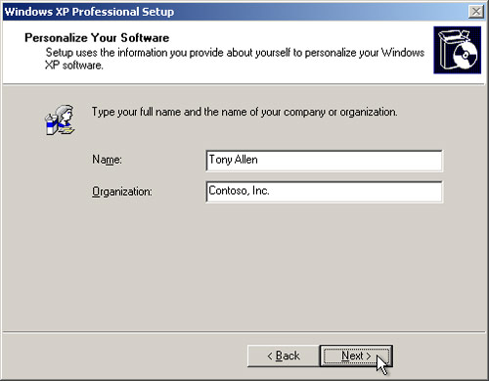
Personalize your Win XP
Type your name and your organization name, click NEXT.

Slide 11
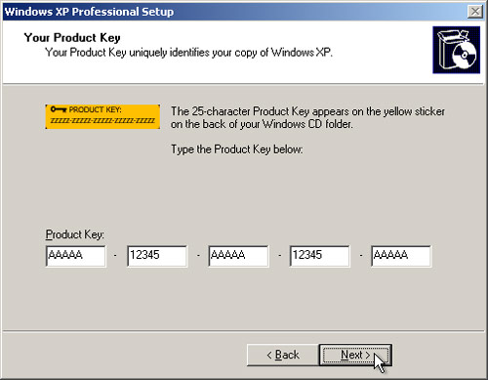
Type in your Product Key
Find your product key from the CD case, type in and click NEXT.

Slide 12
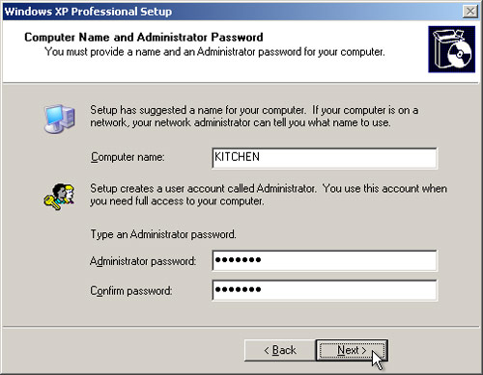
Type in Computer Name & Administrator password
After type in, remember to write the password down, click NEXT.

Slide 13
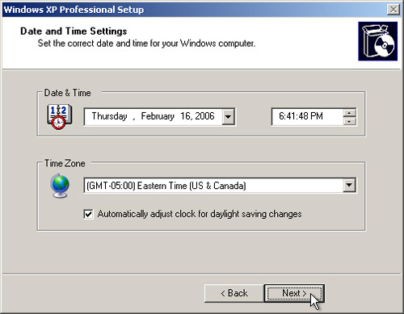
On the Date and Time Settings page
Set your computer’s clock. Then select your time zone, click NEXT.

Slide 14
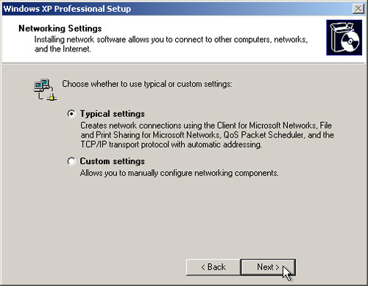
Networking Settings
Select Typical Settings, click NEXT.

Slide 15
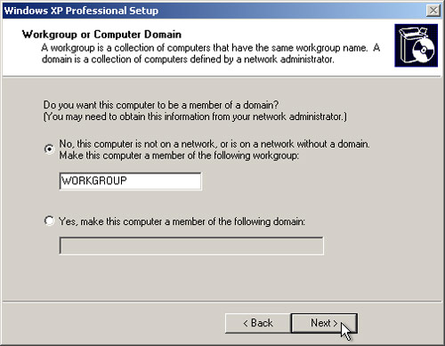
On the Workgroup or Computer Domain page

Slide 16
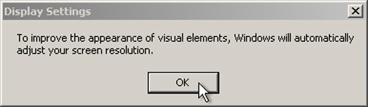
Display Settings

Slide 17
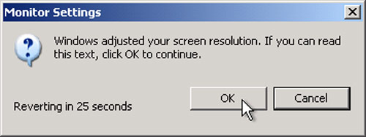
Monitor Settings
Click OK if you can read the text.

Slide 18
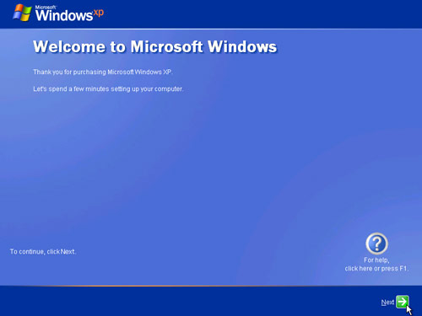
Welcome to Microsoft Windows page
Click NEXT

Slide 19
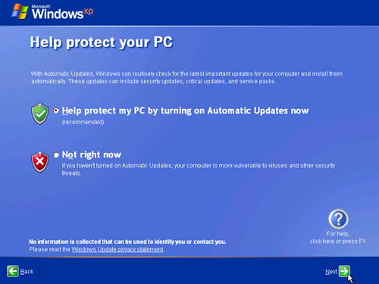
Protect your PC
Click Help protect my PC by turning on Automatic Updates now. Click Next

Slide 20
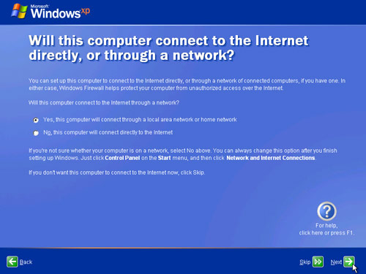
Check the Internet Connection

Slide 21
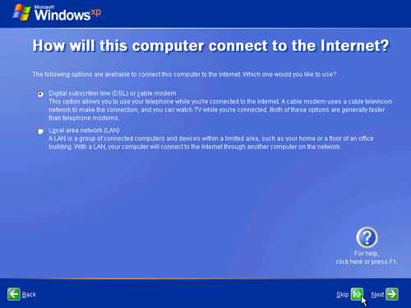
Check the Internet Connection Method

Slide 22
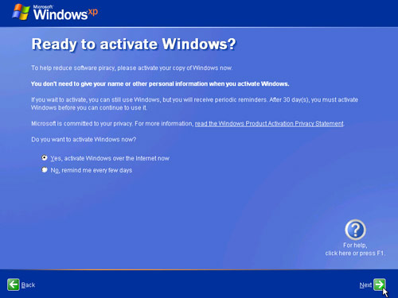
Activate Windows
Click Yes, if you are connected to the Internet. Neither Click No.

Slide 23
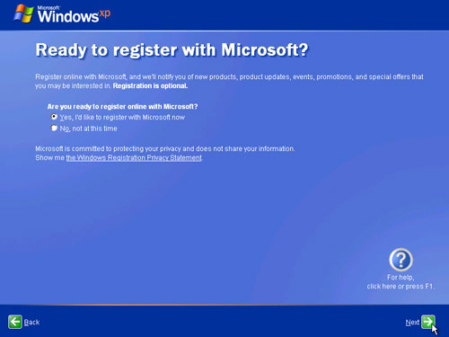
Register with Microsoft
Click YES to register

Slide 24
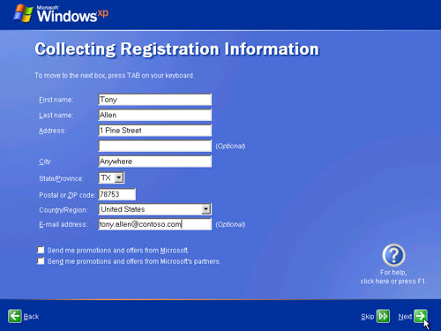
Collecting Registration Information
Complete the form. Then click NEXT.

Slide 25
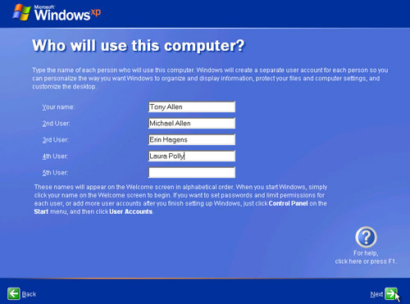
Type in User’s Name

Slide 26
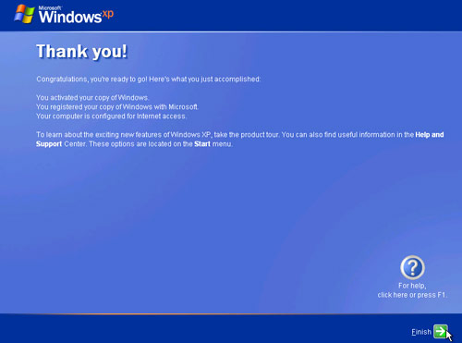
Complete the Installation

Slide 27
End of Installation of Window XP
~ END ~

